Slide 1
Language translation
Programming Language Design and Implementation (4th Edition)
by T. Pratt and M. Zelkowitz
Prentice Hall, 2001
Sections 3.1 - 3.3.1

Slide 2
Program structure
Syntax
What a program looks like
BNF (John Bacus and Peter Naur)
  context free grammars)
  a useful notation for describing syntax
FORTRAN은 문법이 formal하게 정의되지 않았다.
  Blank 무시 ::: Do10I=110 ⬄ Do10I=1,10

Slide 3
Program structure
Semantics
Execution behavior
Static semantics - Semantics determined at compile time:
  var A: integer; Type and storage for A
  int B[10]; Type and storage for array B
  float MyProcC(float x;float y){...}; Function attributes
Dynamic semantics - Semantics determined during execution:
  X = ``ABC'' SNOBOL4 example: X a string
  X = 1 + 2; X an integer
  :(X) X an address; Go to label X

Slide 4
Aspects of a program
Declarations - Information for compiler
  var A: integer;
  typedef struct { int A; float B } C;
Control - Changes to state of the machine
  if (A<B) { ... }
  while (C>D) { ... }
Structure often defined by a Backus Naur Form (BNF) grammar (First used in description of Algol in 1958. Peter Naur was chair of Algol committee, and John Backus was secretary of committee, who wrote report.)
We will see later - BNF turns out to be same as context free grammars developed by Noam Chomsky, a linguist)

Slide 5
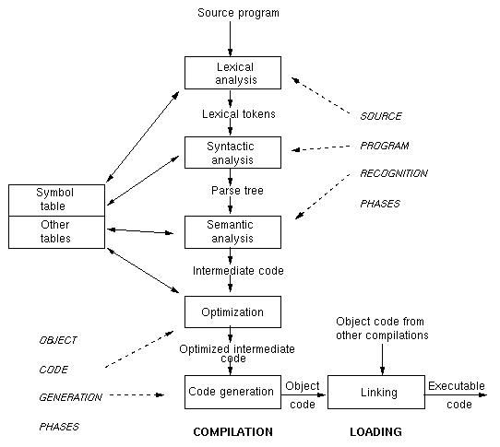
Stages in translating a program

Slide 6
Major stages
Lexical analysis (Scanner): Breaking a program into primitive components, called tokens (identifiers, numbers, keywords, ...) We will see that regular grammars and finite state automata are formal models of this.
Syntactic analysis (Parsing): Creating a syntax tree of the program. We will see that context free grammars and pushdown automata are formal models of this.
Symbol table: Storing information about declared objects (identifiers, procedure names, ...)
Semantic analysis: Understanding the relationship among the tokens in the program.
Optimization: Rewriting the syntax tree to create a more efficient program.
Code generation: Converting the parsed program into an executable form.
We will briefly look at scanning and parsing. A full treatment of compiling is beyond scope of this course.

Slide 7
과정
Lexical analysis (Scanner):
{int a;
float b;
….
a=b+c;
<생성한 토큰>
<kw(keyword)3> <id 1> <kw 8> <kw 4> <id, 2> <kw 8> … <id 1> <kw 7> <id 2> <kw 10> <id 3>

Slide 8
Keyword table
Int | 3
Float | 4
= | 7
; | 8
+ | 10
* | 11
Symbol table
 | id | feature
1 | a | ----
2 | b | ----
3 | c
4

Slide 9
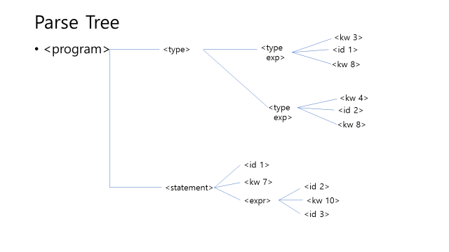
Syntactic analysis
Lexical analysis (Scanner): int a; float b; … a=b+c;

Slide 10
semantic analysis
Symbol table
 | id | feature
1 | a | int
2 | b | float
3 | c
4

Slide 11
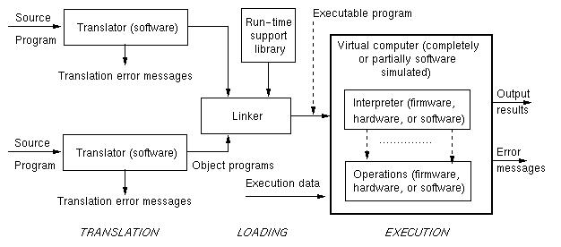
Translation environments

Slide 12
BNF grammars
Nonterminal: A finite set of symbols: <sentence> <subject> <predicate> <verb> <article> <noun>
Terminal: A finite set of symbols: the, boy, girl, ran, ate, cake
Start symbol: One of the nonterminals: <sentence>
Rules (productions): A finite set of replacement rules:
<sentence> ::= <subject> <predicate>
<subject> ::= <article> <noun>
<predicate>::= <verb> <article> <noun>
<verb> ::= ran | ate
<article> ::= the
<noun> ::= boy | girl | cake
Replacement Operator: Replace any nonterminal by a right hand side value using any rule (written ⇒)

Slide 13
Example BNF sentences
<sentence> ⇒ <subject> <predicate> First rule
⇒ <article> <noun> <predicate> Second rule
⇒ the <noun> <predicate> Fifth rule
... ⇒ the boy ate the cake
Also from <sentence> you can derive
⇒ the cake ate the boy
Syntax does not imply correct semantics
Note:
Rule <A> ::= <B><C>
This BNF rule also written with equivalent syntax:
A → BC

Slide 14
Languages
Any string derived from the start symbol is a sentential form.
Sentence: String of terminals derived from start symbol by repeated application of replacement operator
A language generated by grammar G (written L(G)) is the set of all strings over the terminal alphabet (i.e., sentences) derived from start symbol.
That is, a language is the set of sentential forms containing only terminal symbols.

Slide 15

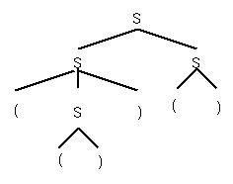
Derivations
A derivation is a sequence of sentential forms starting from start symbol.
Derivation trees:
Grammar: B → 0B | 1B | 0 | 1
Derivation: B ⇒ 0B ⇒ 01B ⇒ 010
From derivation get parse tree
But derivations may not be unique
S → SS | (S) | ()
S ⇒ SS ⇒(S)S ⇒(())S ⇒(())()
S ⇒ SS ⇒ S() ⇒(S)() ⇒(())()
Different derivations but get the same parse tree

Slide 16
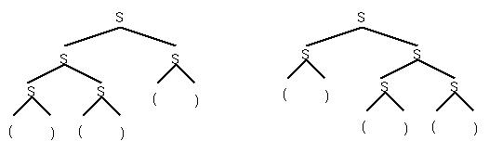
Ambiguity
But from some grammars you can get 2 different parse trees for the same string: ()()()
Each corresponds to a unique derivation:
S ⇒ SS ⇒ SSS ⇒()SS ⇒()()S ⇒()()()
A grammar is ambiguous if some sentence has 2 distinct parse trees.
We desire unambiguous grammars to understand semantics.

Slide 17
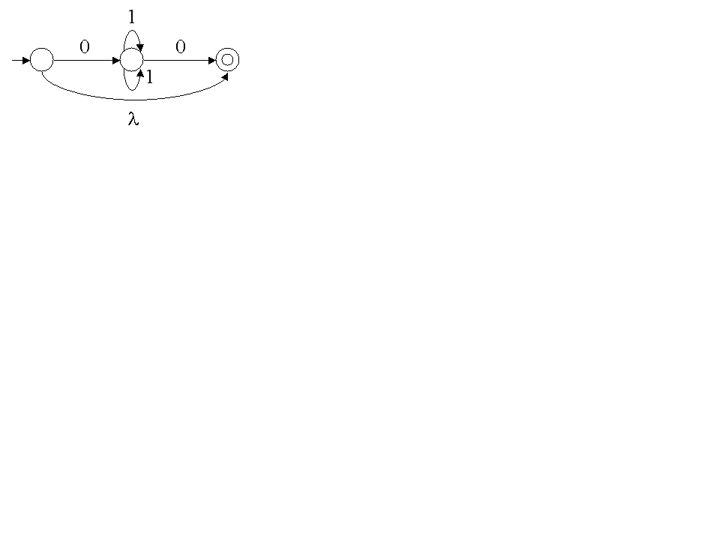
Role of λ
How to characterize strings of length 0? – Semantically it makes sense to consider such strings.
1. In BNF, ε-productions: S → SS | (S) | () | ε
Can always delete them in grammar. For example:
X → abYc
Y → ε
Delete ε-production and add production without ε:
X → abYc
X → abc
2. In fsa - λ moves means that
in initial state, without input
you can move to final state.

Slide 18
Syntax can be used to determine some semantics
During Algol era, thought that BNF could be used for semantics of a program:
What is the value of: 2 * 3 + 4 * 5?
(a) 26
(b) 70
(c) 50
All are reasonable answers? Why?

Slide 19
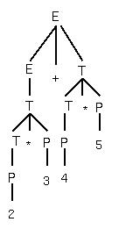
Usual grammar for expressions
E → E + T | T
T → T * P | P
P → i | ( E )
“Natural” value of expression
is 26
Multiply 2 * 3 = 6
Multiply 4 * 5 = 20
Add 6 + 20 = 26

Slide 20
But the “precedence” of operations is only a convention
Grammar for 70
E → E * T | T
T → T + P | P
P → i | ( E )
Grammar for 50
E → E + T | E * T | T
T → i | ( E )
All 3 grammars generate exactly the same language, but each has a different semantics (i.e., expression value) for most expressions.
Draw parse tree of expression 2*3+4*5 for each grammar

Slide 21
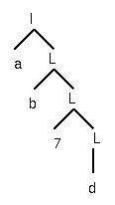
Classes of grammars
BNF: Backus-Naur Form - Context free - Type 2 - Already described
Regular grammars: subclass of BNF - Type 3:
BNF rules are restricted: A → t N | t
where: N = nonterminal, t = terminal
Examples:
Binary numbers: B → 0 B | 1 B | 0 | 1
Identifiers:
I → a L | b L | c L |...| z L | a |...| y | z
L → 1 L | 2 L |...| 9 L | 0 L | 1 |...| 9 | 0 | a L | b L | c L |...| z L | a |...| y | z
ab7d

Slide 22
Other classes of grammars
The context free and regular grammars are important for programming language design. We study these in detail.
Other classes have theoretical importance, but not in this course:
Context sensitive grammar: Type 1 - Rules: α → β where | α |  | β | [That is, length of α  length of β, i.e., all sentential forms are length non-decreasing]
Unrestricted, recursively enumerable: Type 0 -
Rules: α → β. No restrictions on α and β.

Slide 23
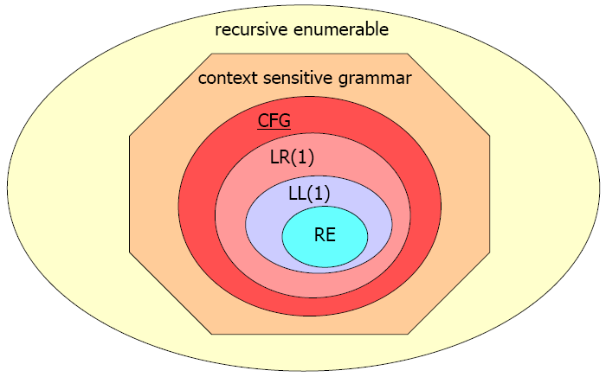
The Big Picture
Chomsky Hierarchy of Language Grammars (1956)

